Slide 1
Fake Review Detection

Slide 2
The fake review problem
Yelp deems 20% of user reviews ‘suspicious’
-Marketwatch, Sep 2013
Amazon cracks down on fake book reviews
-The Verge, Dec 2013
Analysts at Gartner, an IT research company, predict that paid reviews and ratings will make up 10-15 percent of all reviews by 2014. -Business Insider, Dec 2012

Slide 3
Fake or Real?
High Points: Guacamole burger was quite tall; clam chowder was tasty. The decor was pretty good, but not worth the downsides. Low Points: Noisy, noisy, noisy. The appetizers weren't very good at all. And the service kind of lagged. A cross between Las Vegas and Disney world, but on the cheesy side. This Cafe is a place where you eat inside a plastic rain forest. The walls are lined with fake trees, plants, and wildlife, including animatronic animals. A flowing waterfall makes sure that you won't hear the conversations of your neighbors without yelling. I could see it being fun for a child's birthday party (there were several that occurred during our meal), but not a place to go if you're looking for a good meal.
Source: http://www.cs.uic.edu/~liub/FBS/fake-reviews.htm
FAKE!!

Slide 4
The perfect training dataset?
There is no ‘gold-standard’ of fake reviews data for classifier training.
Amazon Mechanical Turks (AMT) generated fake reviews not as good as ‘real world’ fake reviews.
Yelp Academic Dataset –
Does not indicate if the reviews are pre-filtered or post-filtered reviews.
And there are no labels for individual reviews.

Slide 5
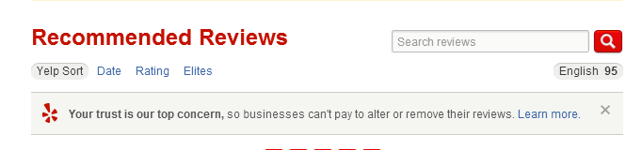
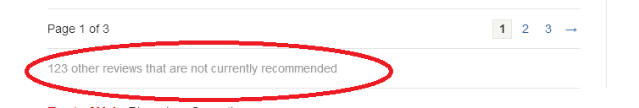
Yelp filtered reviews
Requested Yelp to provide filtered reviews data. No luck as it falls under sensitive category. ☹

Slide 6

I’ll get my own data!

Slide 7
Selenium to the rescue
Selenium package and chrome web driver for web scrapping.
Grabbed ‘Recommended’ and ‘Not Recommended’ reviews from Yelp.
Scraped the user pages of reviewers to get reviewer specific details.

Slide 8
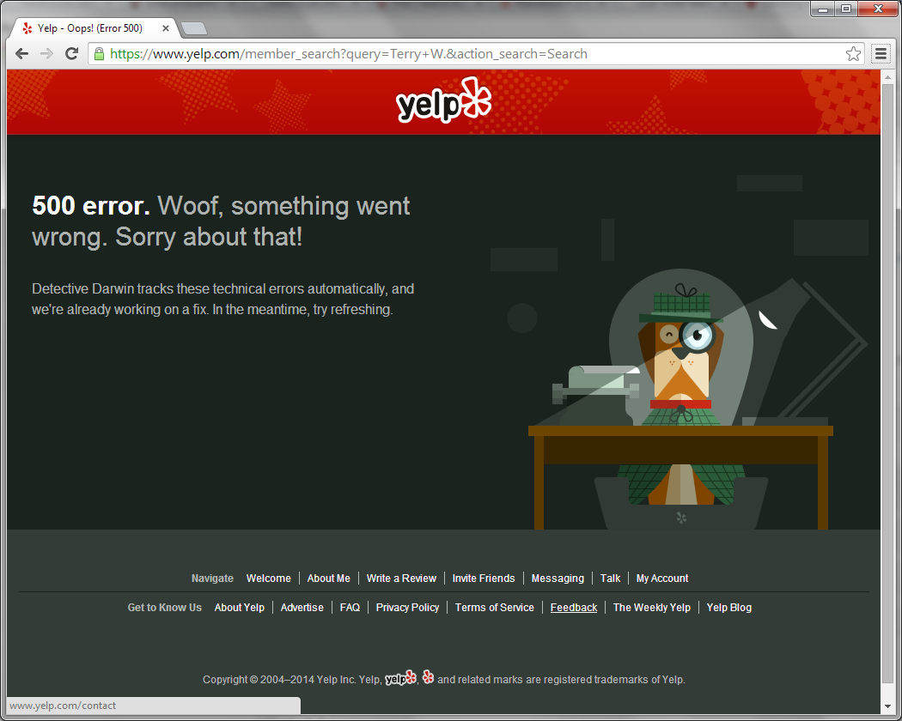
Beware of the Dog!
Yelp measure to prevent DDOS attacks. Webscrapping speed has to be slow to avoid this message.

Slide 9
Linguistic Analysis
Unigrams –
Tagging the Parts of Speech of a text. Example would be adjectives, nouns, adverbs.
Bigrams –
Combination of parts of speech. Specifically
adverbs + adjectives/adverbs
Example: “Really good”, “Exceptionally nice”
Exclamations!!!!!

Slide 10
Behavioral analysis
Length of the review –
Fake reviewers are paid to increase/decrease business ratings. Small review and an extreme rating might be a significant indicator.
Deviation from other reviewers –
A large deviation from average rating (zscore) might indicate an attempt to influence the ratings.
Number of friends and reviews –
Large number of friends and reviews indicates more active participation and lesser chance of the reviewer being fake.

Slide 11
Behavioral analysis
Activity –
Lot of reviews in short bursts and then long periods of inactivity could indicate a non-genuine reviewer.
Measure used – Review/day
Number of reviews / (Number of days since first review)
-> Really low for inactive account
-> Large value for active accounts

Slide 12
Classifier
Scikit Learn’s SVM classifier
Kernel - Linear
Class weight – Inversely proportional to frequency of the class.
‘Filtered’ class has much lower frequency hence much higher weight than ‘Non-filtered’ class.
Runtime – 25 seconds
Validation – Cross Validation

Slide 13
Statistics
Purely Linguistic features –
Precision - 0.75
Recall - 1.0 (Labels everything as a ‘Real review’!)
Fscore - 0.8571 (Deceptive Fscore)
Purely Behavioral features –
Precision - 0.9245
Recall - 0.7101
Fscore - 0.8032
Combination of Behavioral and Linguistic features –
Precision - 0.9259
Recall - 0.724
Fscore - 0.8130

Slide 14
Conclusion
Linguistic features in themselves do not provide a good indication of whether a review is fake or not.
Behavioral features by themselves do a decent job of identifying the correct classes.
A combination of linguistic and behavioral features provides the best possible indication of whether a review is fake or not.

Slide 15
Future work
There are probably other features like IP addresses, server logs that are being used to filter out ‘suspicious’ reviews by Yelp. Would like to train classifier with these features.
Research more NLP techniques to strengthen the precision of linguistic features.

Slide 16
Papers referred to –
Fake Review Detection: Classification and Analysis of Real and Pseudo Reviews - Arjun Mukherjee, Vivek Venkataraman, Bing Liu, Natalie Glance - University of Illinois at Chicago, Google Inc
Detecting Group Review Spam - Arjun Mukherjee, Bing Liu, Junhui Wang, Natalie Glance, Nitin Jindal - Dept. of Computer Science, University of Illinois at Chicago

Slide 17
Thank you

